Slide 1
User Research Report
Youyou Cheng | June 2021

Slide 2
Executive Summary
The medical app is aiming to increase the availability and accessibility of medical information for people. However, we are in lack of understanding the challenges and needs users are facing. The lack of knowledge may lead to inappropriate solution.
I adopted several user research methodology to better understand the current process users take, uncover their pain points and expectations. Ultimately, to validate the product solution and prioritise tasks.
The objective for this research is to identify opportunities for the product. In this report, I will list three key findings that have been identified and the recommendations against each finding.

Slide 3
Executive Summary
Research goals
The research is based on 5 user interviews, aiming to answer the following:
What is the current process users undertake for doctor consultation.
What services/products currently available on the market
What pain points users encountered during the process and what improvements they want to make.
Key Findings
Users are more likely to book appointments online as it is more available than phone call.
Users are pressed for time. If they can’t reach out to regular GP, they are more likely to use internet to self serve rather than wait. They would like easy and accessible way to self serve to talk to doctors/find medical advice. However, current services and products does not provide enough information to fulfill user needs.
The product could provide two channels: online booking and online consultation, along with doctors information.

Slide 4
Method
All findings are based on semi-structured user interviews.
5 participants shared their experiences and expectations
Supplementary survey study was also provided to validate the findings

Slide 5
Key User Needs and Expectations
Participant 1 | Participant 2 | Participant 3 | Participant 4 | Participant 5
 | “I won’t use the app in an emergency situation” | “Calling GP is very frustrating, the line is always busy.” | “I want to know the doctors details, otherwise it is the same as search online.”
I have regular prescriptions and my regular GP knows me well. | I have two kids and found it was very difficult to book follow up session with doctors during lockdown. | I am an IT professional. I like booking online because it is much easier than phone call. | I’m a student. I can find different ways to reach out to a doctor, but I don’t like waiting. | I am an IT professional. I wish my dentist would have a online booking system.
What do you most want? | What do you most want? | What do you most want? | What do you most want? | What do you most want?
Doctors details Doctors availabilities Chat history | Doctors details Security A copy of the chat | Select regular GP Send prescription Claim within app Chat history | Chat history Doctors details Doctors rating | Doctors availabilities Online booking

Slide 6
Key User Needs and Expectations
Things prevent user from using medical app
Things make user want to use medical app
Booking habit: Users often make appointments with regular GP.
Situation: Users won’t use medical app in emergency situation.
Alternative ways: There are other means to use, including Google search, Telehealth, Health Direct.
Self service: Users like easy and accessible way to self serve the information.
Less frustration: Users are frustrated about making phone calls to book appointments and waiting for a long time before seeing the doctor.
Lack of information: Google, Telehealth and Health Direct do not provide doctors information.

Slide 7
Key Findings
Users are more likely to book appointments online. The research shows users who used online appointment booking system prefer making appointments online.
Two key journeys identified Online booking and Online consultation.
User expectations indicate while online booking could be the core value of the product, online chat is another method they are likely to use.
User would like to see doctors information. 3 out of 5 participants want to see doctors information, it will help them make the right choice. It could make the product more appealing comparing to other services/products currently available on the market.

Slide 8
Key Recommendations
Users are more likely to book appointments online.
The product should have a dedicated section for user’s next appointment.
The product could give user the choice to cancel or reschedule an appointment.
The product could integrate with email calendar for reminders and notifications.

Slide 9
Key Recommendations
Two key journeys identified.
The product should provide a online chat option for doctors who is available online.
The product should store and give user the option to review previous conversation.

Slide 10
Key Recommendations
User would like to see doctors information.
The product could include the following filters:
Gender
Location
Availability
The product should have a page for each doctor’s information.

Slide 11
Next Steps
Gather more data using survey
Create measurement metrics based on user interview data and survey result
Run research synthesis and priorities tasks based on measurement metrics

Slide 12
Appendix

Slide 13
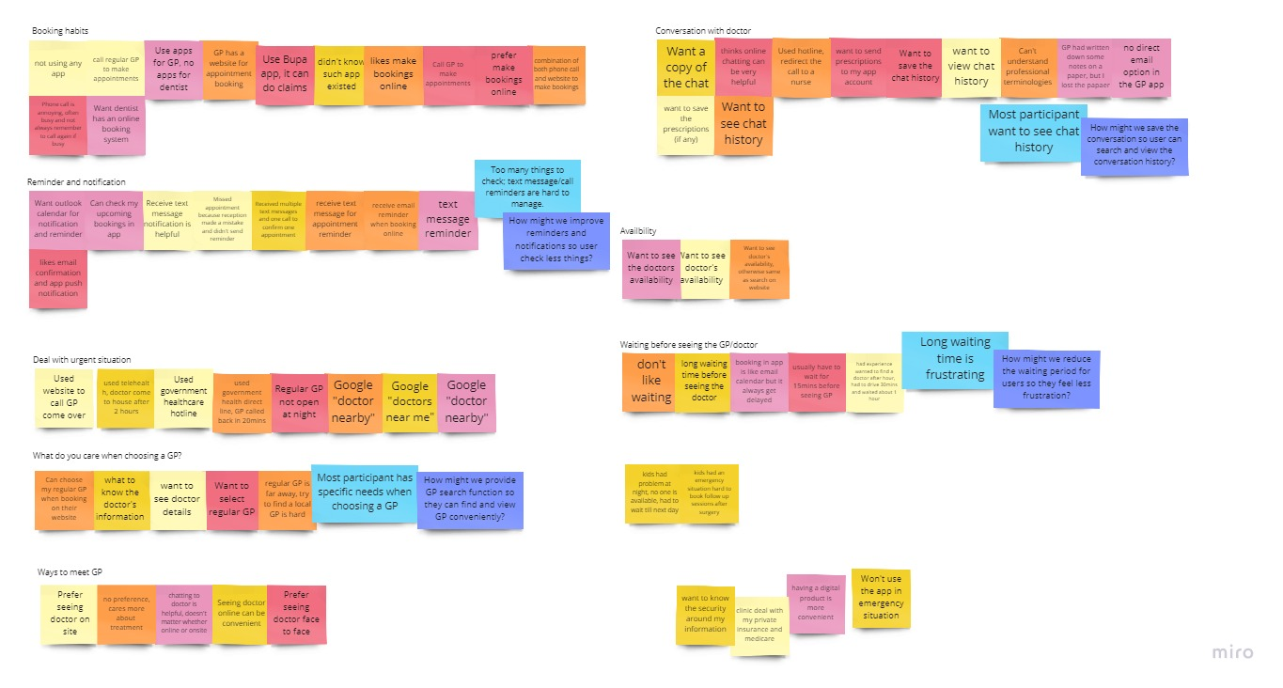
Data Collection and Analysis

Slide 14
Supplementary Materials
User Interview Data and Research Synthesis
https://miro.com/app/board/o9J_l-OTiTA=/
Screen Designs
https://whimsical.com/medical-app-project-1-design-GqKvgHCVc4EbacqnAhnKCc

Slide 15
Thank You
Youyou Cheng | June 2021

